Slide 1
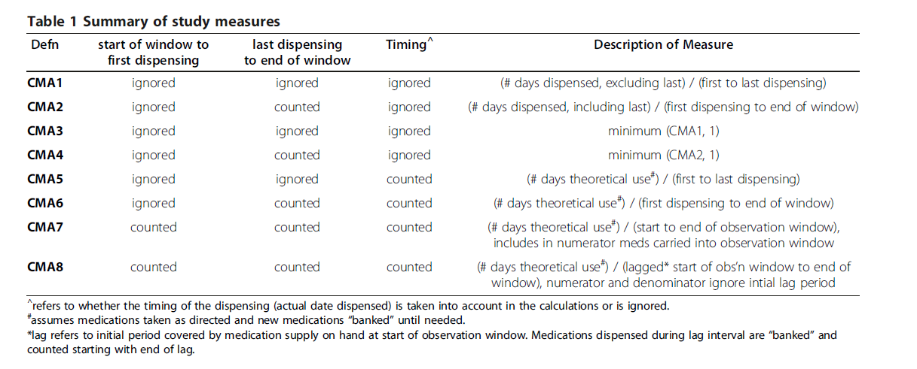
Continuous multiple-interval measures of medication availability (CMA)
Vollmer WM, Xu M, Feldstein A, Smith D, Waterbury A, Rand C. Comparison of pharmacy-based measures of medication adherence. BMC Health Serv Res. 2012;12:155. Published 2012 Jun 12. doi:10.1186/1472-6963-12-155

Slide 2


CMA1 scenario
Observation window
Prescription Fill Date
05/04/2020
+10 days
30
06/03/2020
Step 1:
90 days = Total days supplied
03/25/2020
+5 days
30
04/24/2020
02/19/2020
30
03/20/2020
-15 days
02/04/2020
+4 days
30
03/05/2020
01/01/2020
+6 days
30
01/31/2020
11/26/2019
30
12/26/2019
12/30/2019
“Start of OW”
01/01/2020
“Date of first fill”
03/25/2020
“Date of last fill”
04/26/2020
“End of OW”
Step 3:
Step 2:
84 days = |“Date of first fill” – “Date of last fill”|
$$MPR= \frac{Total days supplied}{|Date of first fill −Date of last fill|}$$
$$MPR=1.07 = \frac{90}{84}$$

Slide 3


CMA2 scenario
Observation window
Prescription Fill Date
05/04/2020
+10 days
30
06/03/2020
Step 1:
90 days = Total days supplied
03/25/2020
+5 days
30
04/24/2020
02/19/2020
30
03/20/2020
-15 days
02/04/2020
+4 days
30
03/05/2020
01/01/2020
+6 days
30
01/31/2020
11/26/2019
30
12/26/2019
12/30/2019
“Start of OW”
01/01/2020
“Date of first fill”
03/25/2020
“Date of last fill”
04/26/2020
“End of OW”
Step 3:
Step 2:
116 days = |“Date of first fill” – “Last date of OW”|
$$MPR= \frac{Total days supplied}{|Date of first fill −Last date of OW|}$$
$$MPR=0.78 = \frac{90}{116}$$

Slide 4
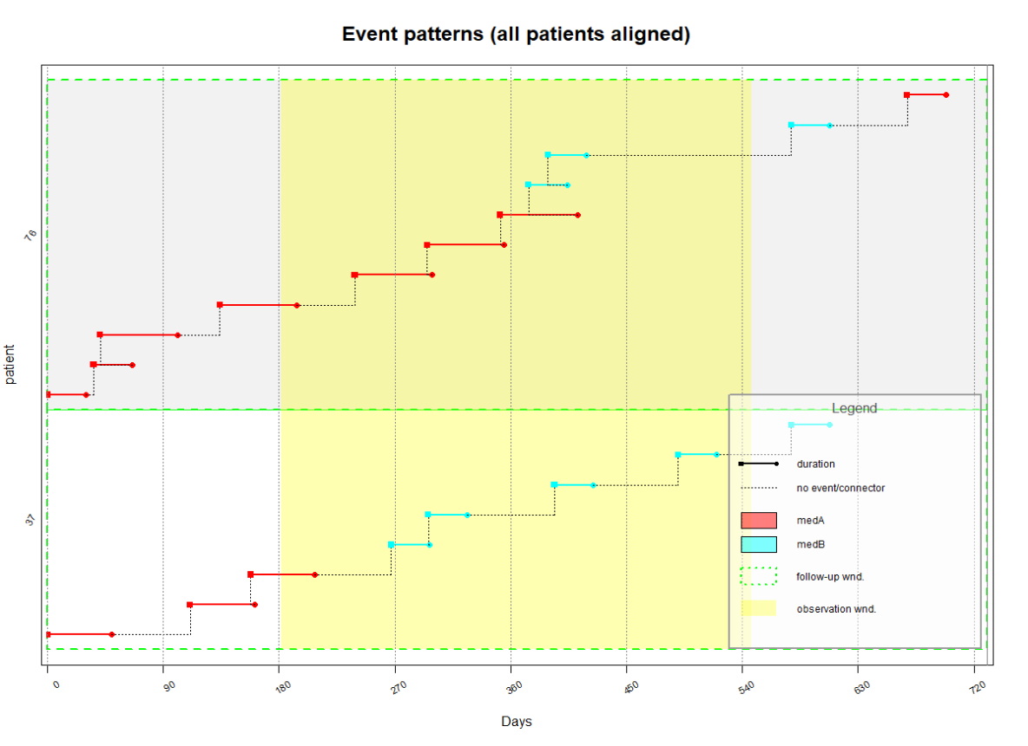

Slide 5
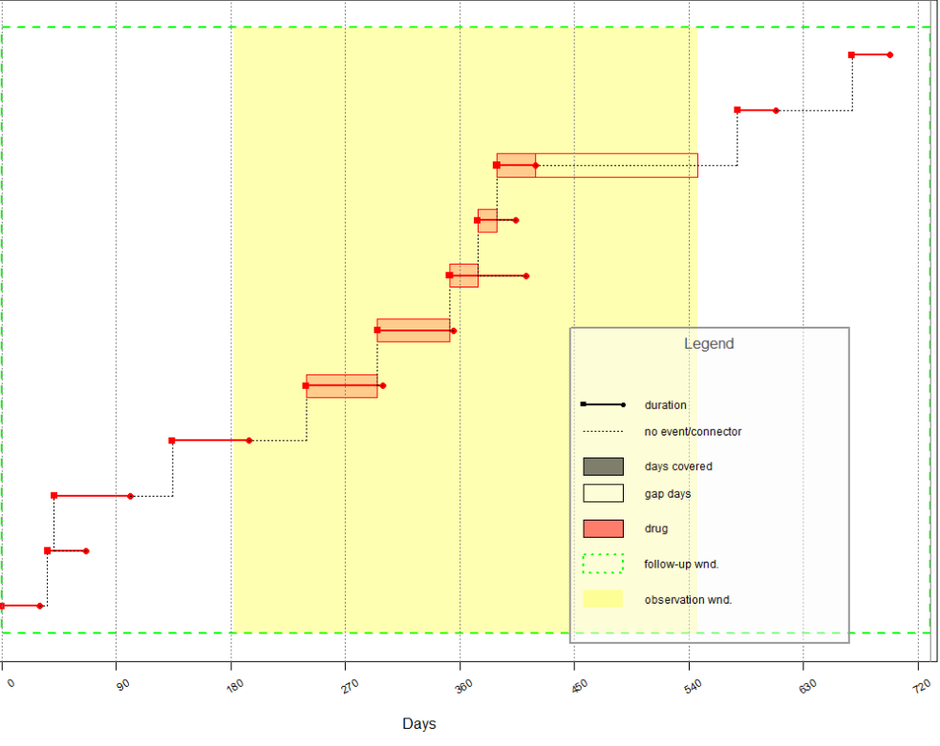
CMA1 – MPR
Subject = 76
10/11/2037
11/10/2037
07/13/2037
08/12/2037
+159 days late
01/05/2037
02/04/2037
+159 days late
-15 days early
12/21/2036
01/20/2037
-38 days early
11/29/2036
01/28/2037
-3 days early
10/03/2036
12/02/2035
-4 days early
08/08/2036
10/07/2036
04/25/2036
06/24/2036
+45 days late
01/23/2036
01/23/2036
-25 days early
+33 days late
01/18/2036
02/17/2036
12/13/2035
01/12/2036
+6 days late

Slide 6
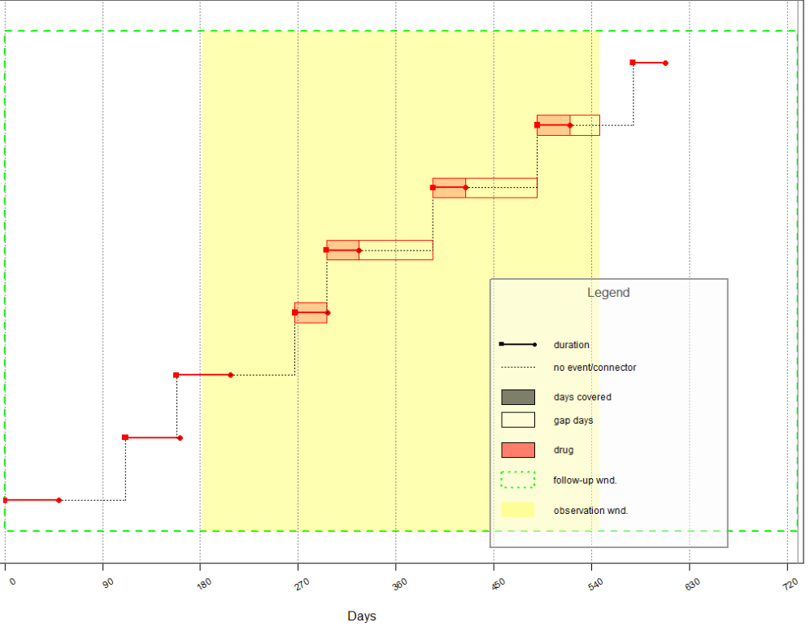
CMA1 – MPR
Subject = 37
09/12/2037
08/13/2037
+58 days late
06/08/2037
+66 days late
05/09/2037
+68 days late
01/31/2037
-1 day early
01/02/2037
02/01/2037

Slide 7
CMA5 – MPR
Subject 76
10/11/2037
11/10/2037
07/13/2037
08/12/2037
+159 days late
01/05/2037
02/04/2037
+159 days late
-15 days early
12/21/2036
01/20/2037
-38 days early
11/29/2036
01/28/2037
-3 days early
10/03/2036
12/02/2035
-4 days early
08/08/2036
10/07/2036
04/25/2036
06/24/2036
+45 days late
01/23/2036
01/23/2036
-25 days early
+33 days late
01/18/2036
02/17/2036
12/13/2035
01/12/2036
+6 days late

Slide 8
Resources
AdhereR package on the CRAN (link)
AdhereR developer GitHub site (link)
Rpubs tutorial (link)
GitHub site exercise (link)

